Slide 1










DEPARTMENT OF ELECTRONICS & TELECOMMUNICATION ENGINEERING
PRESENTS
2.0
A 24-HOUR HARDWARE HACKATHON
POWERED BY
ROUND 2 Submission

Slide 2

Introduction
2.0
A 24-HOUR HARDWARE HACKATHON
Team Name: Team Smart Signal
Member Names:
Arshita Pal
Garv Makhija
Varda Gupta
College Name: Sharda University

Slide 3

Problem Statement Overview
2.0
A 24-HOUR HARDWARE HACKATHON
Title: Smart Home Environment Monitoring and Control System
Introduction:
In modern homes, maintaining a healthy and comfortable environment is crucial for well-being.
Traditional monitoring systems are often limited in functionality and require manual intervention.
Key Issues:
Lack of real-time monitoring of environmental parameters (temperature, humidity, air quality).
Inefficient energy usage due to manual control of devices (fans, lights).
Difficulty in detecting gas leaks or hazardous air quality.
Limited integration of various sensors and devices for a holistic view of home conditions.
[Team Name]:
[Team Name]: Team Smart SIgnal

Slide 4
Highlighted Problems
2.0
A 24-HOUR HARDWARE HACKATHON
Highlighted Problems:
1. Real-Time Monitoring:
Inability to monitor indoor air quality and environmental conditions continuously.
2. Energy Inefficiency:
Manual control leads to unnecessary energy consumption and higher utility bills.
3. Safety Concerns:
Delayed detection of gas leaks or poor air quality can pose health risks.
4. Integration Challenges:
Difficulty in integrating multiple sensors and devices into a cohesive system.
Consequences of the Problems:
Health Risks: Increased respiratory issues and discomfort.
Higher Costs: Inefficient energy use leads to higher bills.
Safety Hazards: Risk of gas leaks and fire.
Integration Issues: Confusion from managing multiple devices.
[Team Name]:
[Team Name]: Team Smart SIgnal

Slide 5
The Solution Blueprint
2.0
A 24-HOUR HARDWARE HACKATHON
Proposed Solution:
Develop a Smart Home Environmental Monitoring and Control System using the ESP32-S3 WROOM module.
Key Components:
Sensors: DHT11 (temperature and humidity), MQ-6 (gas detection), LEM LV25-P (current sensing).
Display: Adafruit SSD1306 OLED for real-time data visualization.
Control: Relay module for automated control of devices.
System Features:
Real-time monitoring of environmental parameters.
Automated control of devices based on sensor readings.
Alerts for gas leaks and poor air quality.
[Team Name]:
[Team Name]: Team Smart SIgnal

Slide 6
Bill Of Materials
2.0
A 24-HOUR HARDWARE HACKATHON
System Architecture:
Microcontroller: ESP32-S3 WROOM as the central processing unit.
Sensor Integration: Connect DHT11, MQ-6, and LEM LV25-P to the ESP32 for data collection.
Data Display: Use the Adafruit SSD1306 OLED to display real-time data.
Control Mechanism: Implement relay control for devices based on sensor thresholds.
Software Development:
Programming Environment: Use Arduino IDE for coding the ESP32.
Libraries: Utilize libraries for DHT11, MQ-6, and SSD1306 for easy integration.
Data Processing: Implement algorithms for data analysis and decision-making.
[Team Name]:
[Team Name]: Team Smart SIgnal

Slide 7
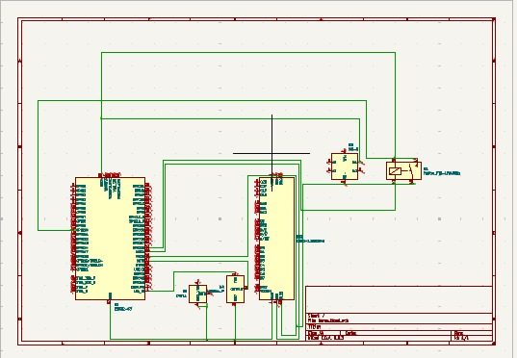
Schematic diagram
2.0
A 24-HOUR HARDWARE HACKATHON
[Team Name]:
[Team Name]: Team Smart SIgnal

Slide 8
Impact and Benefits
2.0
A 24-HOUR HARDWARE HACKATHON
Impact :
Enhanced Safety: Early detection of gas leaks and poor air quality.
Improved Health: Better indoor conditions promote well-being.
Energy Efficiency: Reduced energy consumption and lower bills.
Increased Comfort: Real-time adjustments for optimal living conditions.
Benefits :
Cost Savings: Lower utility and maintenance costs.
User Convenience: Centralized control via mobile devices.
Environmental Sustainability: Smaller carbon footprint.
Peace of Mind: Increased safety and monitoring reassurance.
[Team Name]:
[Team Name]: Team Smart SIgnal

